Slide 1



PROJECT:
>>Determine number of edges , vertices in the undirected graph using adjacency matrix.
PRESENTED TO:
Dr. Mohammad Salah Uddin
Associate Professor
Department of Computer Science & Engineering

Slide 2


“Our Team”
Name | Roll
Md. Tuhin Alam | 2024-3-60-441
Sajid Ahnaf Sahaf | 2024-3-60-449
Sakib Khandakar | 2024-3-60-442
Al Amin | 2024-3-60-448

Slide 3
“Project Overview:”
Goals:
Tasks:
Generate a random adjacency matrix for undirected graphs.
Degree Calculation:
Degrees: Number of total degree.
Analyze the computational complexity:
Theoretically: Determine complexity based on algorithm design.
Empirically: Measure performance during execution.
01
Determine the edges , degree and time.
Measure execution time for graph generation and degree computation.
Visualize execution time vs. n using Excel.
a. Fit a polynomial trendline.
b. Compare observed results with
theoretical complexity.
02
03

Slide 4
“Introduction:”
“Graph:”
A graph is a collection of nodes (vertices) and edges (connections) that represent relationships or associations between pairs of nodes.
“Adjacency Matrix:”
A graph can be classified into two types:
1. Undirected Graph:
2. Directed Graph (Digraph):
An adjacency matrix is a way to represent a graph using a grid of numbers. Each row and column in the grid represents a node (or vertex) in the graph.
>>>If there’s an edge (a connection) between two nodes, we put a 1 in the grid where the row and column intersect.
>>>If there’s no edge, we put a 0.
In the project we only use directed graph. So the defination of the directed graph are given below:
“Undirected Graph:”
An undirected graph is a type of graph in which the edges have no direction. This means that if there is an edge between two vertices, say A and B, you can travel from A to B and also from B to A without restriction.

Slide 5
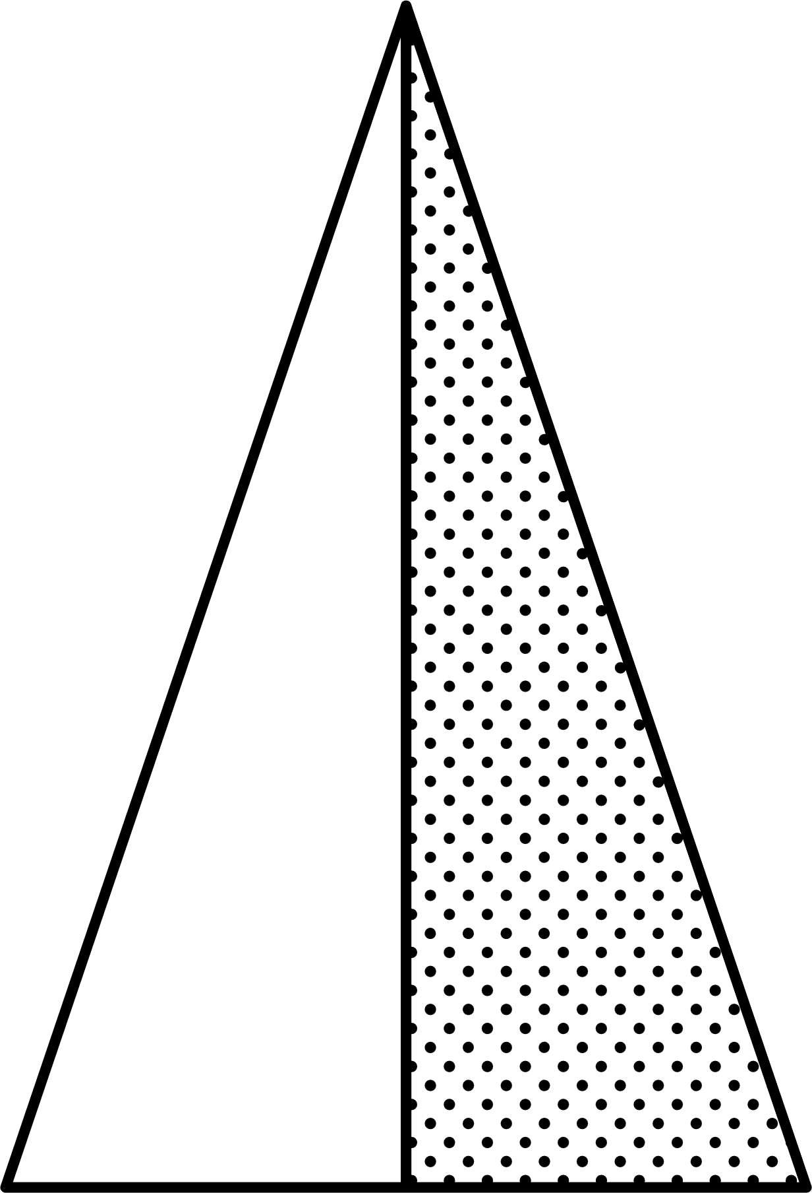
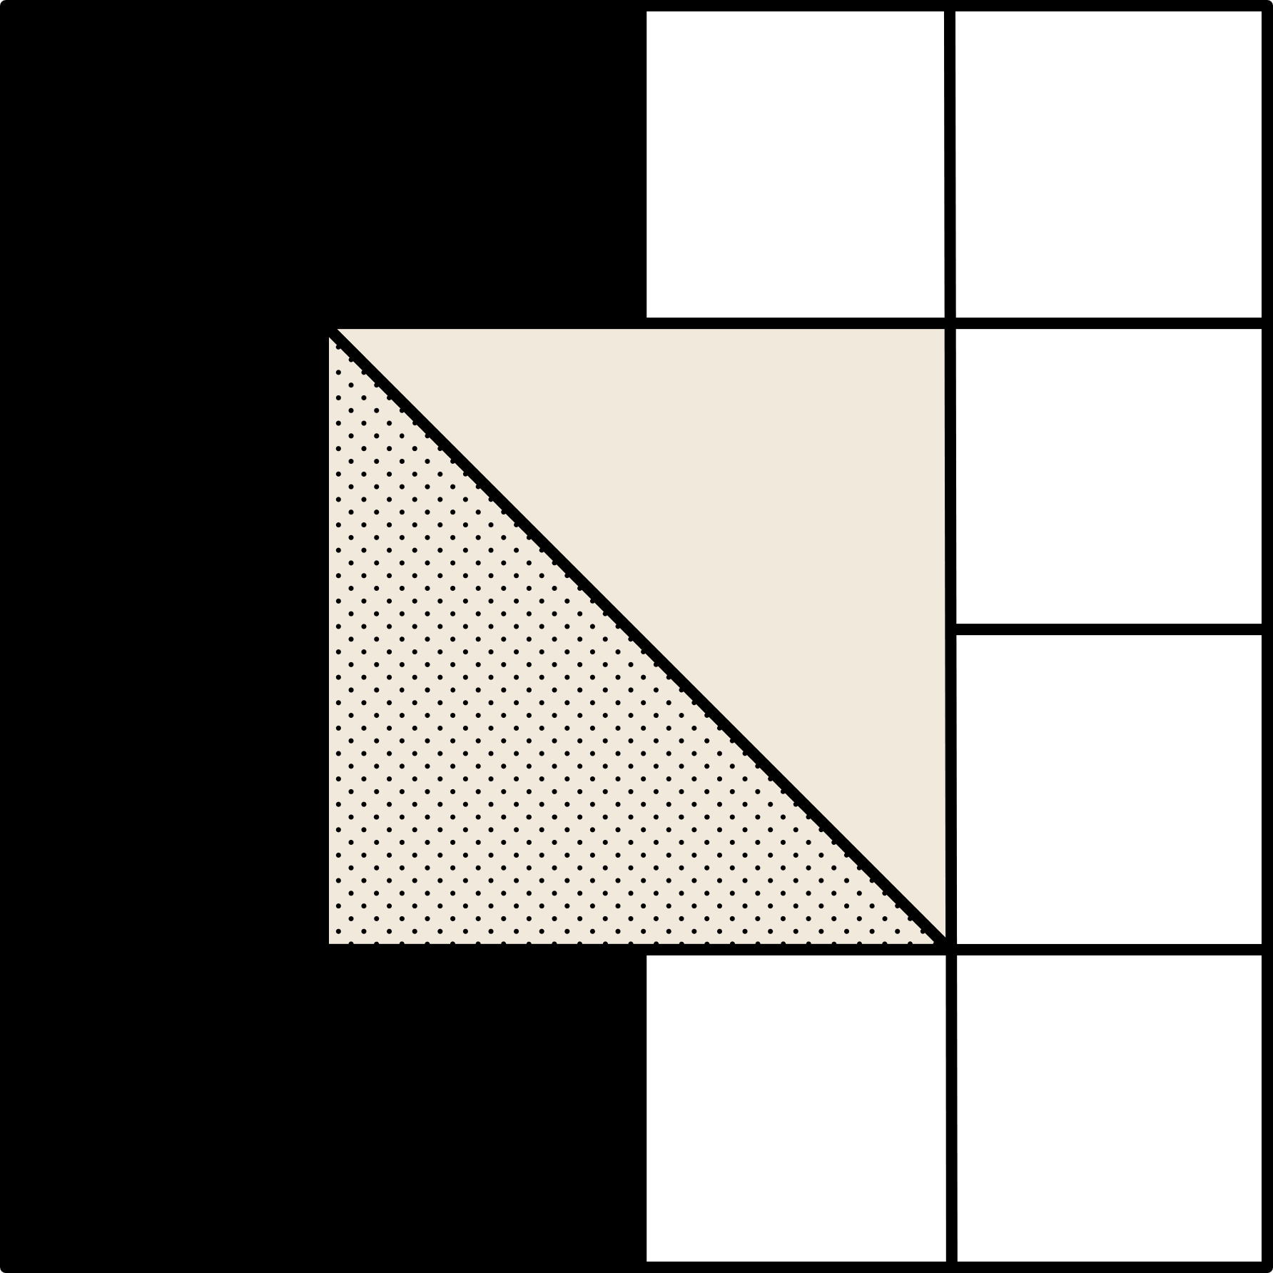
“Methodology:”
Briefly discuss the key Steps for the project.
1st Step:
2nd Step:
3rd Step:
4th Step:
Generate adjacency matrix.
Populate with random edges
Compute degrees
Measure computational time.

Slide 6
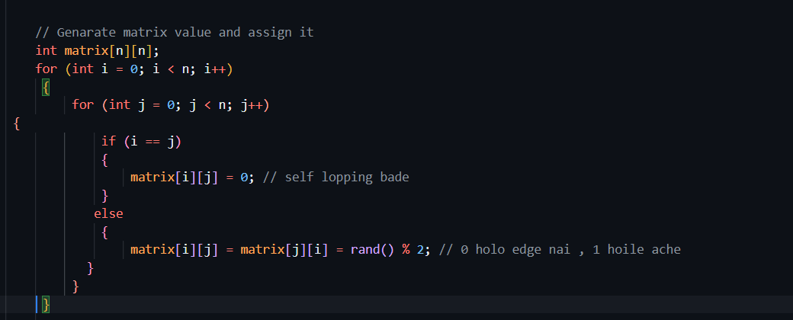
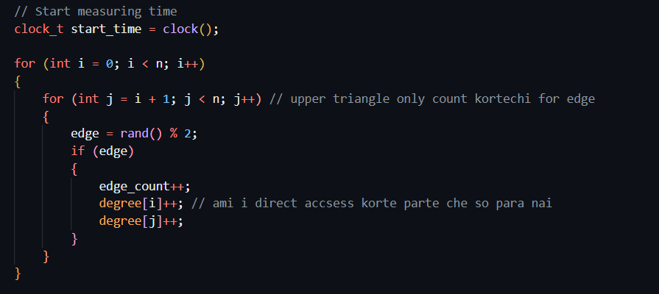
“Code Overview”
→ Genarate Adjacency Matrix:
→Counting the edges and degree:
→The matrix is of size (n ), represented as a 2D array for efficiency.

Slide 7

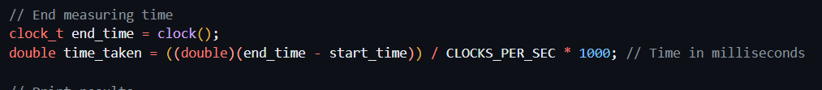
“Code Overview”
→Measuring Execution Time
→Time Measurement:
→Use clock() to measure the time before and after graph generation and degree calculation.
→Display the time in milliseconds.

Slide 8
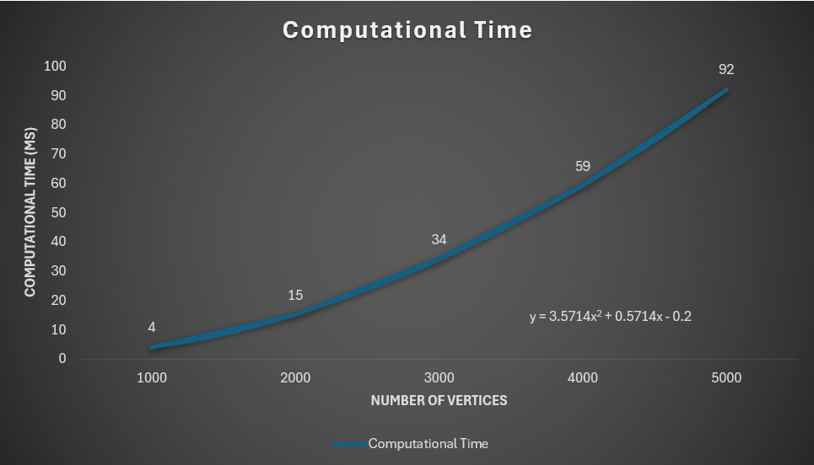
“Graph Analysis”
A polynomial trendline was added to the graph, showing a quadratic relationship.
Trendline Equation:
The polynomial equation shows the time complexity.
We need to put the different values for (n) in the input of the code to get different computational time. The following table shows the computational times value for different value of (n)
y = 3.5714x^2+0.5714x-0.2
The table for the graph (n vs t)
Number of Nodes | Computation Time
1000 | 4 ms
2000 | 15 ms
3000 | 34 ms
4000 | 59 ms
5000 | 92 ms
Fig: Computational Time vs Number of Nodes

Slide 9
“Time Complexity Analysis:”
Using the Excel graph and polynomial trendline:
1. The derived equation is of the form:
T(n) = an^2 + bn + c,
indicating a quadratic relationship.
2. Coefficients a, b, and c are obtained from the trendline equation.
Calculation of the Time Complexity from the Graph:
Fig: Computational Time vs Number of Nodes

Slide 10
“Time Complexity Analysis:”
Equation
(y = 3.5714x^2+0.5714x-0.2):
Time Complexity:
O (n^2 + e), but since e ≤ n^2, the complexity simplifies to O(n^2).

Slide 11
“Conclusion”
Observations
→Execution Time Analysis:
1. Increases quadratically with n.
2. Degree computations dominate run-time.
→Accuracy:
Consistency between theoretical and empirical complexity.

Slide 12
“Thank You!”
Team Scorpion

